Slide 1

Box Plot
Tells about distribution of data in a data set
Divides the dataset into three quartiles
Represents minimum, maximum, median, first quartile and third quartile
Syntax: boxplot(x, data, notch, varwidth, names, main)
x is a vector or a formula
data is the data frame
notch is a logical value. Set as TRUE to draw a notch.
varwidth is a logical value. Set as true to draw width of the box proportionate to the sample size
names are the group labels which will be printed under each boxplot.
main is used to give a title to the graph.

Slide 2
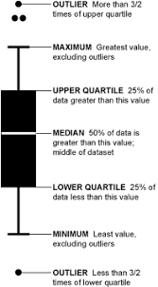
Box Plot Interpretation

Slide 3
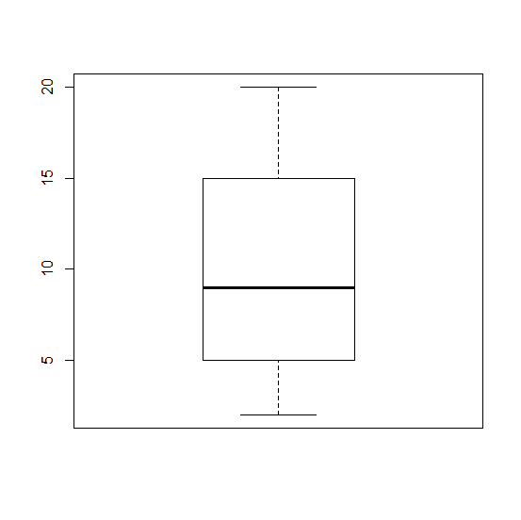
Box Plot: Example 1
Q1. x=c(2, 3, 5, 6, 8, 10, 12, 15, 18, 20)
Min = 2
Max = 20
Median = 9
1st Quartile = 5 [Median of lower half]
or ceil(n/4)^{th} element
3rd Quartile = 15 [Median of upper half] or ceil(3n/4)^{th} element
Q2. For y=c( 7, 4, 4, 7, 2, 9, 10, 6, 7, 3, 8, 8), find min, max, median, Q1 and Q3.
Verify the same using a box plot.
Note: Median {(n + 1) ÷ 2}^{th} value, where n is the number of values in a set of data. In order to calculate the median, the data must first be ranked (sorted in ascending order). The median is the number in the middle. Median = the middle value of a set of ordered data.

Slide 4
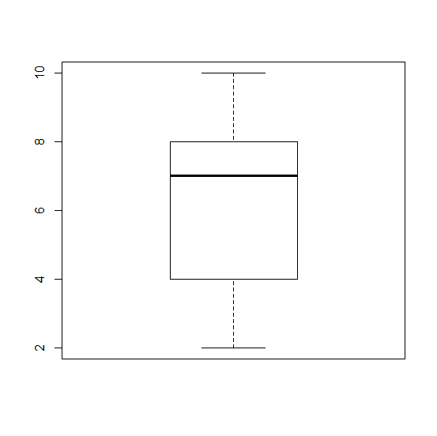
Box Plot: Example 2
y=c( 7, 4, 4, 7, 2, 9, 10, 6, 7, 3, 8, 8 )
Find min,max,Q1,Median and Q3
Verify the same using box plot
Q1=4
Q3=8
Median=7
Min=2
Max=10

Slide 5
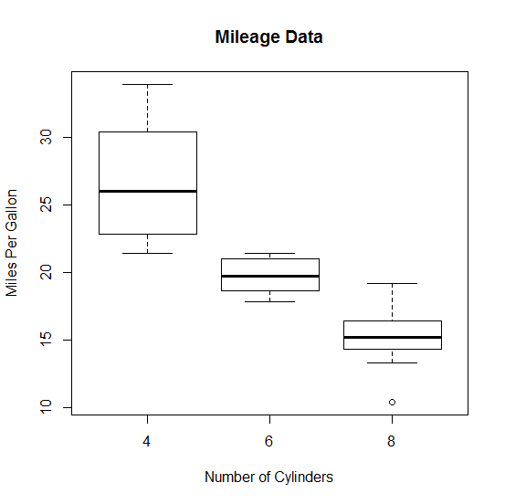
Box Plot: Example
# MPG w.r.t Cyl
boxplot(mpg ~ cyl, data = mtcars, xlab = "Number of Cylinders", ylab = "Miles Per Gallon", main = "Mileage Data")

Slide 6
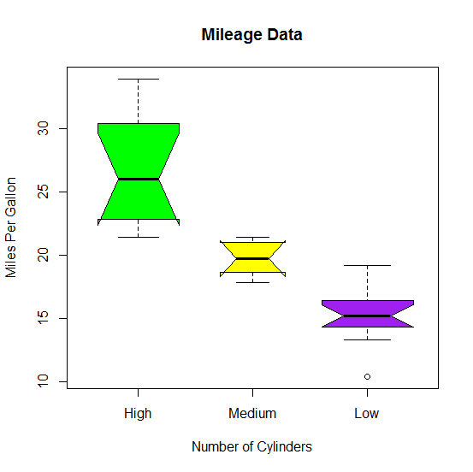
Box Plot: Notch & Varwidth
boxplot(mpg ~ cyl,data = mtcars, xlab = "Number of Cylinders", ylab = "Miles Per Gallon", main = "Mileage Data", notch = TRUE, varwidth = TRUE, col = c("green","yellow","purple"), names = c("High","Medium","Low"))

Slide 7
Exercise - 01
Using the dataset ‘airquality’, attempt the following:
Draw a boxplot for airquality dataset and comment on the comparative data distribution of attributes.
Draw a boxplot for monthwise Ozone level
boxplot(airquality)
boxplot(airquality$Ozone~airquality$Month,col=2:6, xlab="month", ylab="ozone")

